Slide 1

New Teacher Orientation
Introduction to commonly used applications

Slide 2
Office 365 Equivalents in Google
Office 365 | Google
Outlook E-mail Calendar | Gmail Google Calendar
OneDrive | Drive
Teams | Google Classroom Meet Chat
Forms | Forms
Word, PowerPoint, Excel | Docs, Slides, Sheets
OneNote | No Equivalent

Slide 3
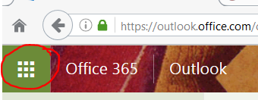
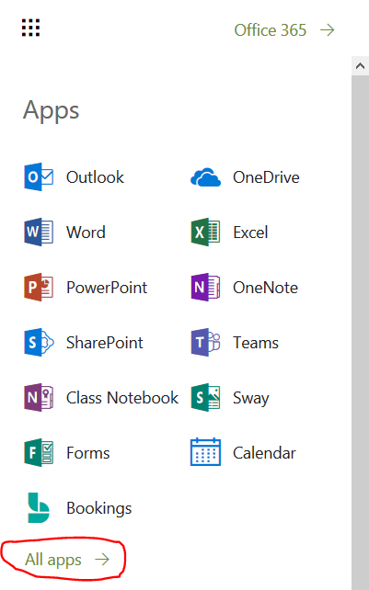
Accessing Office 365
Open the Edge browser
Go to office.com directly, or go to stgrsd.org and select 'Office 365' under the 'Staff' tab
Sign-in using your school email address (first initial last name, i.e. ggreen@stgrsd.org) and password; the password is the same one you use to log-on to the computer.
In the top left corner, you should see a nine-dot grid, this is your ‘application picker.’​
Click the grid and a list of apps should appear directly beneath it. The most popular ones will be there, but if you don’t see what you’re looking for there is a link to all your apps at the bottom.​

Slide 4
Outlook
Mail
  All staff and students have emails, typically first initial followed by last name
    Staff = @stgrsd.org
    Students = @k12.stgrsd
Calendar
  Everyone has a personal calendar, under My Calendar, it is listed as 'Calendar'.
    Only you can see this unless you share it with someone else
  Some schools and groups create group calendars to manage events

Slide 5
IT Ticketing/IT Equipment Set-up
https://it.stgrsd.org/ for all it tickets.
  This is our help desk where an IT Technician will come and diagnose your hardware/software issues that may have occurred.
http://techblog.stgrsd.org/index.php/it-equipment-set-up-booking/ is the equipment booking.
  If you are in need of, equipment set-up such as a projectors, mics, audio equipment for a special events this is where you would want to book the set-ups.

Slide 6
OneDrive
Cloud file storage
Can make folders to organize, create, and save all filetypes
Can share files and access files shared with you
When creating a new file, recommended to go to OneDrive first and create it there, that way you know where it’s saved
Files can be accessed from any device with Internet connectivity

Slide 7
Teams
Many professional groups, clubs and activities, and every class has a Team
  Class Teams are automatically created and rostered
Landing page for a Team is for conversations, like a discussion board
Channels can be created for separate topics
There is a 'Files' tab that functions like a Team OneDrive
Assignments can be used to push out assignments to all students and receive work
Grades shows assignments graded using Teams
  Important Note: Team's Grades are not linked to PlusPortals
Meetings – similar to Zoom

Slide 8
Forms
Digital Survey and Quizzing Tool
Word, PowerPoint, and Excel
On-line version of document, slideshow, and spreadsheet applications
‘Lighter’ versions, slight reduction in capabilities to function better in the cloud environment
Formatting errors can occur if you are switching between the desktop and cloud versions of the app
Recommended to stay in the OS365 version whenever possible

Slide 9
Zoom
On-line video conferencing tool
Most staff will receive a basic school account
We have a limited number of licensed accounts for staff members hosting meetings with community members
PlusPortals/Rediker
Student and Staff Database Management System
Used for attendance and official grades
Parents and SRS students have access

Slide 10
Clever
For most other applications students and staff will access them via Clever.com
This includes:
  I-Ready
  Amplify Reading
  HMH
  Code.org
LAN School
This tool allows teachers to monitor student devices while in class
Classes in grades 5-10 will have licenses to use this product

